Slide 1

Search With Logical Operation
Presenter: Tran Nhat Anh

Slide 2
Agenda
Overview.
Search history.
Benefits of search with logical operation.
Practical application.
Background knowledge.
Algorithm deployment.
Demo (Visual C# .Net)

Slide 3


Overview
Continue
Search problems.
Search with simple condition.
Only AND operator is being used.
Does not support merge many search result.
Search condition are usually not saved to reuse in the future.
⇒ How can we merge or compare search results ?

Slide 4
Overview
Search with logical operation.
It’s simple search but use more than one operator.
Combining simple search conditions by many operators (NOT, AND, OR,…)
Simple Condition
A
Simple Condition
C
Simple Condition
B
(A AND C) NOT B
NOT A
NOT B
NOT C
C NOT ( A AND B)

Slide 5
Search History
What is search history:
Search condition for every search times.
Stored search conditions into database.
Can be edit and deleted by user.
Can be used by “Searching with Logical Operation”.
AND
Search History A
NOT
Search History B
OR
Search History C
Search History D

Slide 6


Benefits of Search with Logical Operation.
For user:
Simple search conditions can be reused.
Allow user customize search conditions.
Find exactly what user want to find.
Save a lot of time for searching.
For administrator:
Easy to deploy.
Save cost to maintenance system.

Slide 7

Practical application.
Patent Explorer – FREONTEO project:
Allow client find any patent information by patent’s content, number, publish date,…as simple search condition.
Combine many simple conditions to find exactly what client want by operator.
⇒ Considered a superior solution in terms of accuracy and comprehensiveness

Slide 8
Background knowledge.
Continue
Data structure and Algorithm
AND
Condition A
OR
Condition B
Condition C
XOR
OR
Condition E
Condition F
NOT
OR
Condition G
Condition H
[A and (B or C)]
XOR
[(E or F) not (G or H)]

Slide 9

Background knowledge.
Continue
Logical Operator: AND/OR/NOT
Variables: Left AND Right
Example: 1 AND 0
Object Oriented Programming
Logical Operator
NOT
OR
AND

Slide 10
Background knowledge
Object Oriented Programming
Condition: text, date time, number…
Search Condition
Search Date
Search Number
Search Text

Slide 11
Algorithm Deployment
Relation flow:
AbstractSearchFilter
AbstractOperatorSearch
AndOperatorSearch
OrOperatorSearch
TextSearch
NumberSearch
DateSearch
NotOperatorSearch

Slide 12
Algorithm Deployment
Continue
Search Condition Classes.
AbstractSearchFilter class:
Temporary table
Abstract Search() function.
CreateTempTable() function.
Child class:
TextSearch
DateSearch
NumberSearch
…..

Slide 13
Algorithm Deployment
Continue
Logical Operation Classes.
AbstractOperatorSearchFilter class:
Input parameters (List AbstractSearchFilter)
Abstract Search() function.
CreateTempTable()
Child class:
AndOperatorSearch
OrOperatorSearch
NotOperatorSearch
XorOperatorSearch
Inheritance from AbstractSearchFilter class.

Slide 14

Algorithm Deployment
Continue
Convert search condition.
AndOperatorSearch
TextSearch A
OrOperatorSearch
TextSearch B
DateSearch C
XorOperatorSearch
OrOperatorSearch
DateSearch E
NumberSearch F
NotOperatorSearch
OrOperatorSearch
TextSearch G
NumberSearch H
[A and (B or C)]
XOR
[(E or F) not (G or H)]

Slide 15
Algorithm Deployment
Run algorithm:
Just only call XorOperatorSearch.Search() function to execute.
XorOperatorSearch.Search()
SearchResult
Stored in temporary table

Slide 16
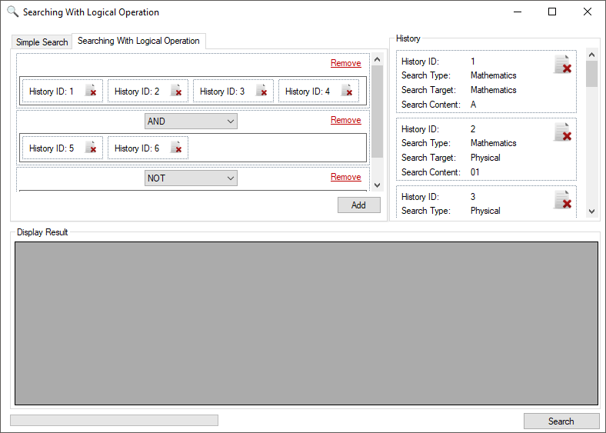
Demo (Visual C# .Net)

Slide 17

Question & Answer

Slide 18


